Slide 1
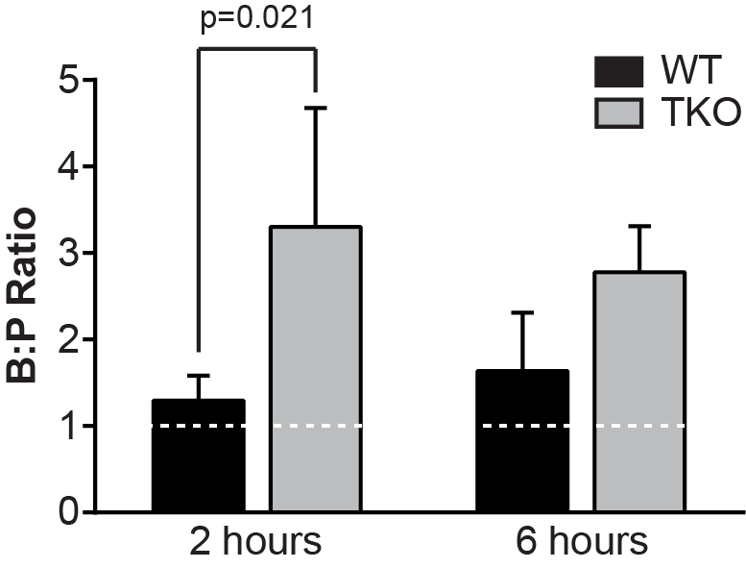
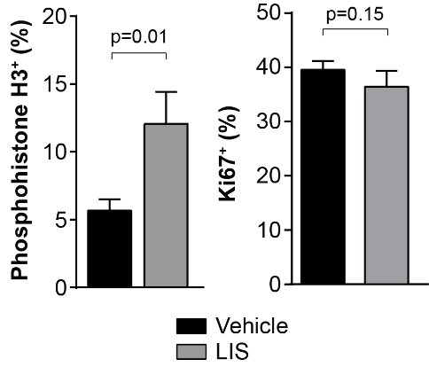
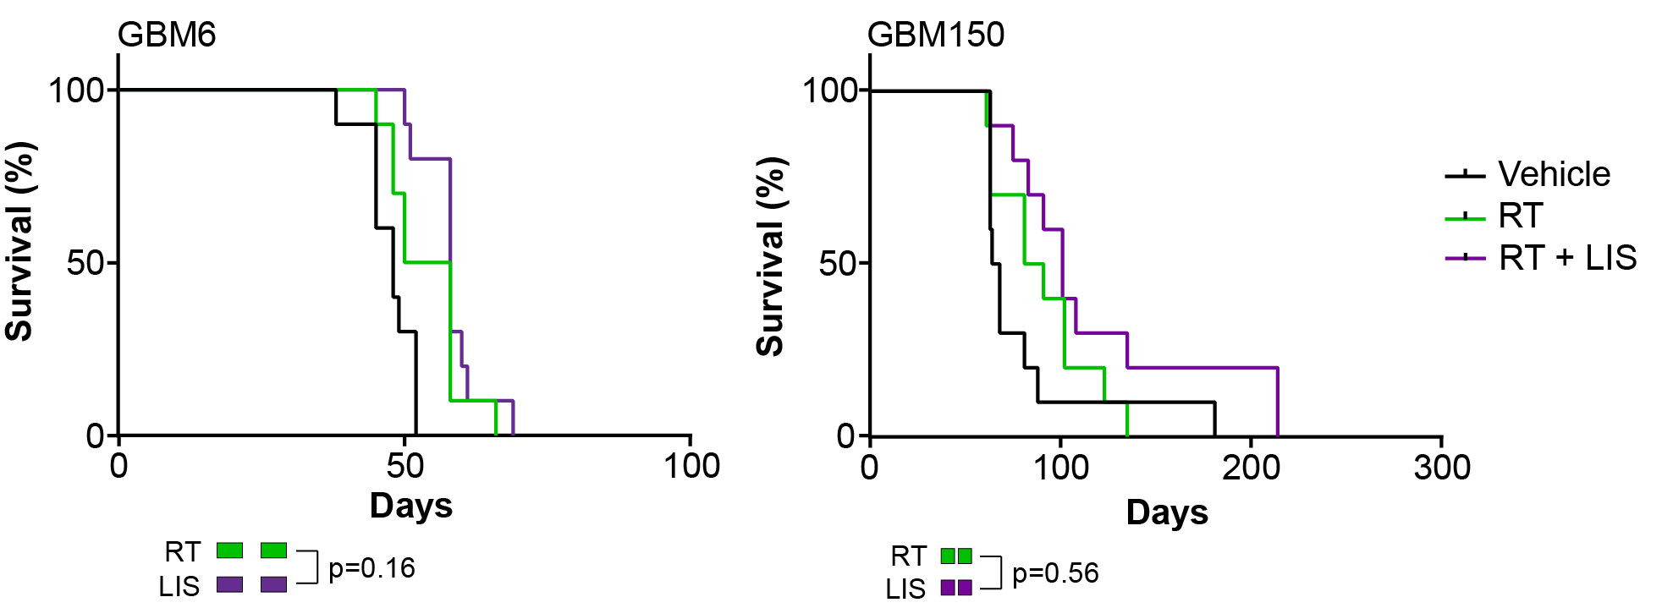
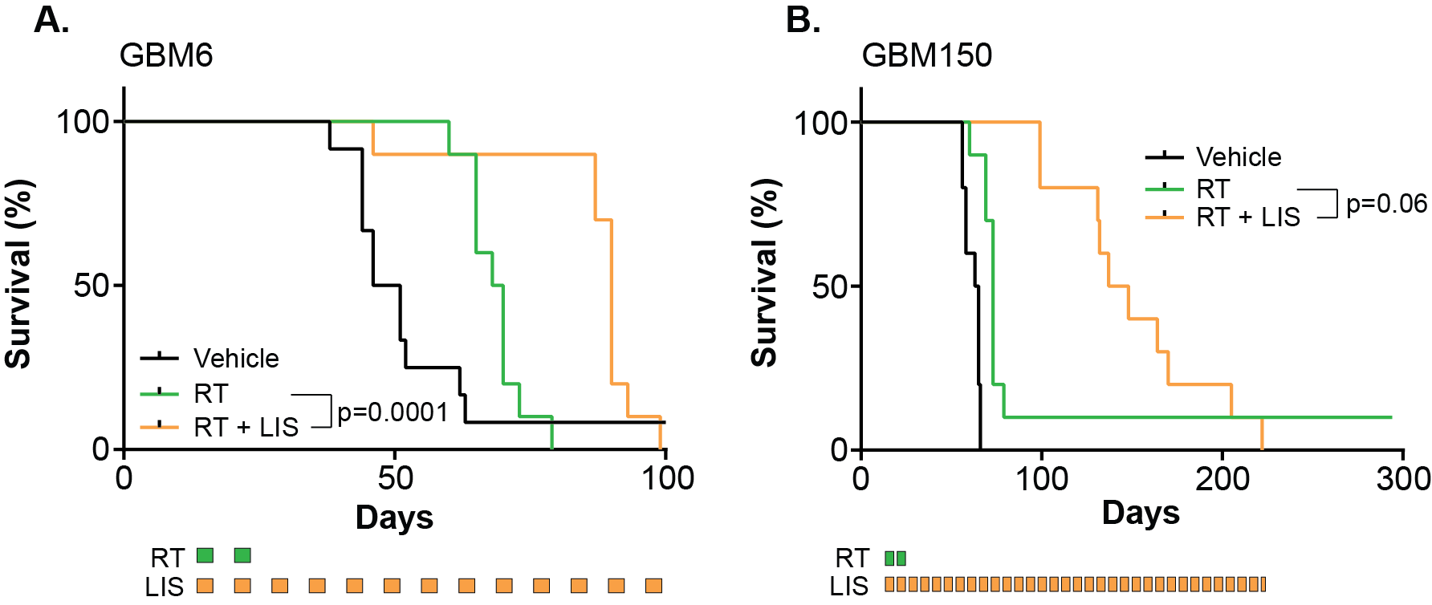
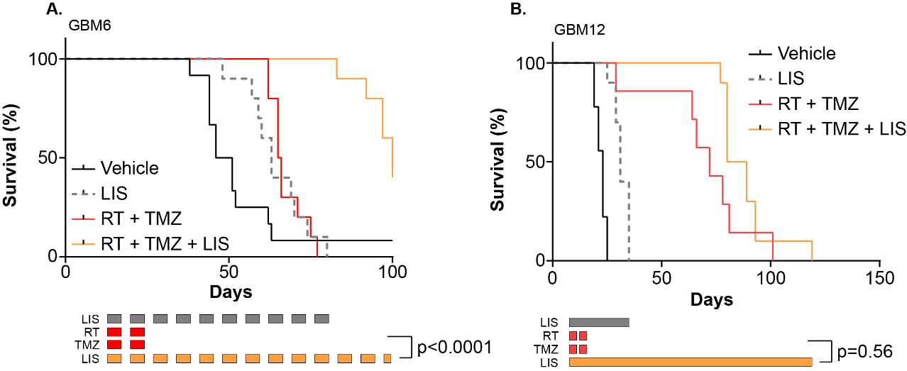
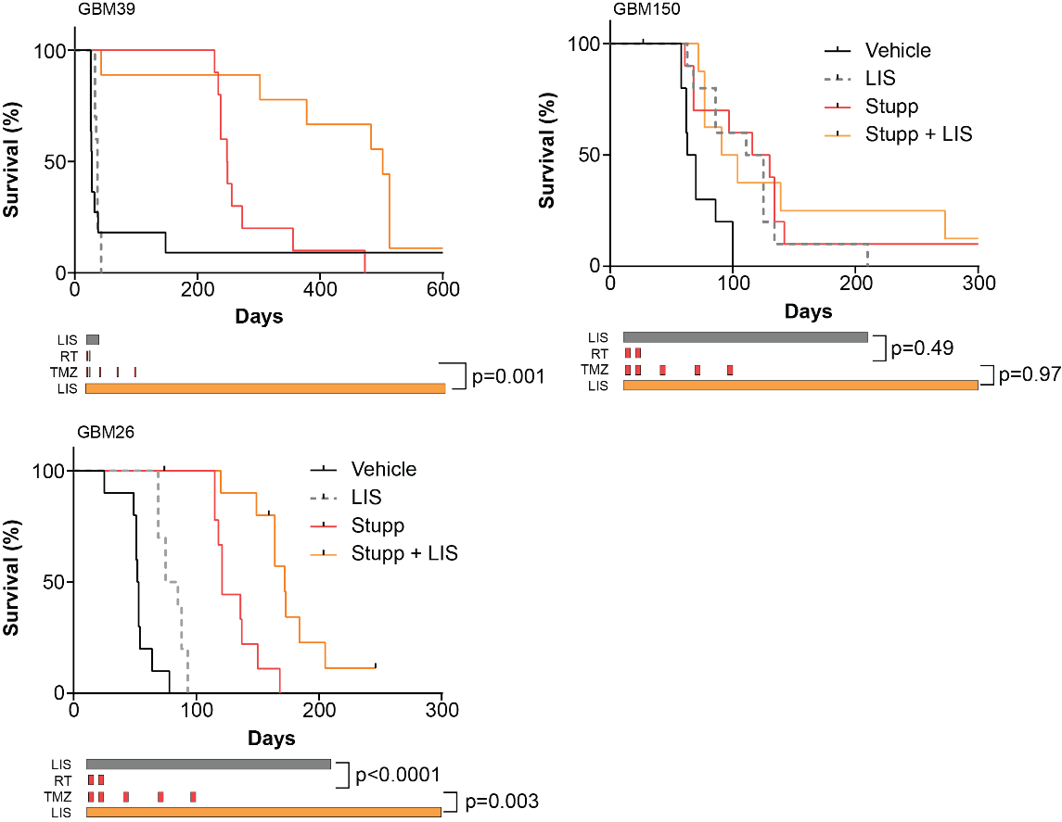
Modeling the clinical paradigm of BAL101553 deployment in patient-derived xenografts (PDX) of glioblastoma (GBM)
Danielle M. Burgenske¹, Ann C. Mladek¹, Jenny L. Pokorny², Heidi A. Lane³, Felix Bachmann³, Rachael A. Vaubel⁴, Mark A. Schroeder¹, Katrina K. Bakken¹, Lihong He¹, Zeng Hu¹, Brett L. Carlson¹, Surabhi Talele⁵, Gautham Gampa⁵, Matthew L. Kosel⁶, Paul A. Decker⁶, Jeanette E. Eckel-Passow⁶, William F. Elmquist⁵, Jann N. Sarkaria¹
¹Division of Radiation Oncology, Mayo Clinic, Rochester, MN, ²OncoMed Pharmaceuticals, Redwood City, CA, ³Basilea Pharmaceutica International Ltd, Basel, Switzerland, ⁴Division of Laboratory Genetics and Genomics, Mayo Clinic, Rochester, MN, ⁵Department of Pharmaceutics, Minneapolis, MN, ⁶Division of Biostatisticians, Mayo Clinic, Rochester, MN.
Abstract
Structure and Brain Distribution
LIS does not demonstrate classic radiosensitizing effects in vivo.
Prolonged LIS dosing significantly extends survival gains from RT +/- TMZ.
LIS induces mitotic arrest.
  Lisavanbulin (LIS; BAL101553) is the prodrug of BAL27862, a microtubule-binding, tumor checkpoint controller and potential radiosensitizer. These studies evaluated optimal integration of LIS with standard of care radiation therapy (RT) and/or temozolomide (TMZ) using GBM PDX models. Distribution across the blood brain barrier was evaluated after a single 30 mg/kg oral LIS dose, and concentrations of the active metabolite BAL27862 were measured by liquid chromatography-tandem mass spectrometry. Similar BAL27862 concentrations were detected in the brain (B) and plasma (P) at both two (B:P ratio 1.29) and six hours (B:P ratio 1.64) post-dose. An in vivo screen of LIS monotherapy across 14 orthotopic GBM PDX models showed significant survival benefit (p<0.01) in seven models (median survival extension 24-87%). Extending from these results, LIS was evaluated in several of the sensitive models in combination with RT +/- TMZ. Two MGMT unmethylated PDXs, GBM6 and GBM150, were treated with vehicle or two weeks of RT +/- LIS. LIS dosing during the RT dosing period did not significantly improve median survival in either line (GBM6 survival with RT 54 days vs RT/LIS 58 days, p=0.16; GBM150 RT 86 days vs RT/LIS 101 days, p=0.21). However, prolonged LIS dosing from the start of RT until mice reached a moribund state demonstrated added benefit (GBM6 median 90 days vs RT 69 days, p=0.0001; GBM150 median 143 days vs RT 73 days, p=0.06). In GBM6, prolonged LIS dosing also significantly extended survival when combined with 2 weeks of RT/TMZ (median 101 days vs 66 days, p<0.0001), while LIS alone or RT/TMZ resulted in similar median survivals (63 days vs 66 days, respectively; p=0.68). This same RT/TMZ/LIS benefit was not seen in the MGMT methylated GBM12. Subsequent experiments were performed to evaluate integration of prolonged LIS dosing with concurrent RT/TMZ followed by 3 cycles of adjuvant TMZ (‘Stupp’ regimen). In MGMT methylated GBM39, LIS alone did not significantly extend survival, but LIS addition to the Stupp regimen doubled median survival (Stupp 249 days vs Stupp/LIS 502 days, p=0.0001). GBM150 demonstrated equal benefit from LIS alone or Stupp regimen (median 118 days vs 123 days, p=0.49). Stupp/LIS showed no additional survival benefit (median 98 days, p=0.97). In a second MGMT unmethylated, TMZ-resistant GBM26 PDX, LIS alone or combined with the Stupp regimen provided significant survival benefit: median survival 53 days for vehicle vs. 80 days for LIS (p=0.0001), 114 days for RT only (p<0.0001), 147 days for RT/LIS (p=0.30 relative to RT), 121 days for ‘Stupp’ regimen alone (p=0.57 relative to RT), and 172 days for Stupp/LIS (p=0.04 relative to Stupp). A follow-up GBM39 study revealed a significant increase in the mitotic marker phospho-histone H3 with LIS treatment relative to vehicle-treated controls (p=0.01) while Ki67 levels were similar (p=0.15). This suggests that LIS induces a mitotic arrest associated with microtubule deregulation. Collectively, these data provide a strong rationale to evaluate lisavanbulin (BAL101553) with RT +/- TMZ in GBM and provided the basis for an ongoing Phase I clinical trial.
Mice bearing orthotopic GBM39 tumors were dosed with 30 mg/kg LIS for eight days before being sacrificed two hours after the final dose. Brains were harvested and fixed in formalin for paraffin embedding. Mitotic events (phospho-histone H3 IHC, left) and proliferation (Ki67 IHC, right) and were scanned using Nuance software and quantified by a certified neuropathologist. Kruskal-Wallis test was used to compare groups.
Left. LIS is a water-soluble prodrug of BAL27862 currently in Phase I/II clinical trials for adult patients with GBM and advanced solid tumors. Given both orally and intravenously, LIS is being evaluated as a single agent and in combination with standard radiation regimens.
Right. FVB mouse strain – wild-type (WT) and MDR1a-/-:MDR1b-/-:BCRP1-/- triple-knockout (TKO) mice were given a single dose of 30 mg/kg LIS orally and sacrificed 2 and 6h post-dose (n=4/timepoint). Following plasma and brain collection, samples were homogenized and levels of the active metabolite BAL27862 were measured via LC-MS/MS. Kruskal-Wallis test was used to compare groups.
Conclusions
Two PDX lines were orthotopically implanted and grown for 13 and 32 days before being randomized into treatment groups. Mice were dosed with vehicle, 2 Gy radiation (RT), or 2 Gy RT + once daily LIS Monday through Friday for two weeks at which point treatment was ended and mice were followed for survival. Log rank tests were used to compare treatment groups.
BAL27862, the active metabolite of Lisavanbulin, demonstrates excellent brain penetration and is not subject to relevant drug efflux.
Lisavanbulin monotherapy produces significant survival benefit in 50% of the GBM PDX models tested, irrespective of MGMT promoter status.
While Lisavanbulin addition does not significantly improve the survival benefits conferred by radiation when dosing is limited to the radiation window, significant survival extensions are observed with prolonged Lisavanbulin dosing.
Lisavanbulin integration with the Stupp regimen can also produce significant survival benefits.
These therapeutic benefits of Lisavanbulin may be achieved through mitotic arrest mechanisms.
Efficacy of LIS monotherapy in orthotopic GBM PDX models
 |  | Median survival (days) |  | Mean survival ± SD (days)
Line | MGMT promoter status | Placebo | LIS | Placebo | LIS | p-value | Change (%)
GBM6 | unmethylated | 48 | 60 | 47 ± 4 | 58 ± 10 | <0.01 | 24%
GBM8 | methylated | 47 | 64 | 48 ± 5 | 64 ± 7 | <0.01 | 36%
GBM10 | unmethylated | 35 | 38 | 35 ± 2 | 38 ± 5 | 0.04 | 10%
GBM12 | methylated | 23 | 31 | 22 ± 2 | 32 ± 3 | <0.01 | 35%
GBM15 | methylated | 71 | 87 | 110 ± 120 | 89 ± 21 | 0.41 | 22%
GBM22TMZ | methylated | 27 | 26 | 26 ± 5 | 27 ± 4 | 0.55 | -4%
GBM26 | unmethylated | 51 | 66 | 52 ± 7 | 71 ± 17 | <0.01 | 31%
GBM39 | methylated | 31 | 57 | 30 ± 3 | 55 ± 14 | <0.01 | 87%
GBM59 | methylated | 45 | 56 | 52 ± 28 | 68 ± 36 | 0.02 | 23%
GBM84 | methylated | 56 | 73 | 58 ± 8 | 68 ± 8 | <0.01 | 29%
GBM108 | unmethylated | 40 | 43 | 41 ± 5 | 49 ± 16 | 0.11 | 12%
GBM115 | unmethylated | 139 | 183 | 146 ± 40 | 199 ± 60 | 0.07 | 31%
GBM122 | unmethylated | 80 | 84 | 83 ± 11 | 90 ± 15 | 0.28 | 5%
GBM150 | unmethylated | 52 | 69 | 52 ± 6 | 84 ± 40 | <0.01 | 32%
Three PDX lines were orthotopically implanted and grown for 7-13 days before being randomized into treatment groups. Top. Mice were dosed with vehicle, RT, or RT+LIS. Bottom. Mice were dosed with vehicle, LIS, RT+TMZ, or RT+TMZ+LIS. RT was given in 2 Gy fractions Monday through Friday for two weeks. LIS was continued until moribund. Log rank tests were used to compare treatment groups.
LIS integration with Stupp regimen can provide survival benefit.
Funding
This work was supported by funding from Basilea Pharmaceutica International Ltd.
Mice were dosed with vehicle, LIS, Stupp regimen, or Stupp regimen + LIS. RT was given in 2 Gy fractions Monday through Friday for two weeks concurrently with 20 mg/kg TMZ. Adjuvant TMZ (50 mg/kg) was given days 1-5 every 28 days for three cycles while LIS was continued until moribund. Log rank tests were used to compare treatment groups
Mice with established orthotopic tumors were treated with 30 mg/kg LIS once daily by mouth until moribund. Log rank tests were used to compare treatment groups.
© 2018 Mayo Foundation for Medical Education and Research

